Slide 1
Hypothesis Testing

Slide 2
Internet Usage Data
Respondent Sex Familiarity Internet Attitude Toward Usage of Internet
Number Usage Internet Technology Shopping Banking
1 1.00 7.00 14.00 7.00 6.00 1.00 1.00
2 2.00 2.00 2.00 3.00 3.00 2.00 2.00
3 2.00 3.00 3.00 4.00 3.00 1.00 2.00
4 2.00 3.00 3.00 7.00 5.00 1.00 2.00 5 1.00 7.00 13.00 7.00 7.00 1.00 1.00
6 2.00 4.00 6.00 5.00 4.00 1.00 2.00
7 2.00 2.00 2.00 4.00 5.00 2.00 2.00
8 2.00 3.00 6.00 5.00 4.00 2.00 2.00
9 2.00 3.00 6.00 6.00 4.00 1.00 2.00
10 1.00 9.00 15.00 7.00 6.00 1.00 2.00
11 2.00 4.00 3.00 4.00 3.00 2.00 2.00
12 2.00 5.00 4.00 6.00 4.00 2.00 2.00
13 1.00 6.00 9.00 6.00 5.00 2.00 1.00
14 1.00 6.00 8.00 3.00 2.00 2.00 2.00
15 1.00 6.00 5.00 5.00 4.00 1.00 2.00
16 2.00 4.00 3.00 4.00 3.00 2.00 2.00
17 1.00 6.00 9.00 5.00 3.00 1.00 1.00
18 1.00 4.00 4.00 5.00 4.00 1.00 2.00
19 1.00 7.00 14.00 6.00 6.00 1.00 1.00
20 2.00 6.00 6.00 6.00 4.00 2.00 2.00
21 1.00 6.00 9.00 4.00 2.00 2.00 2.00
22 1.00 5.00 5.00 5.00 4.00 2.00 1.00
23 2.00 3.00 2.00 4.00 2.00 2.00 2.00
24 1.00 7.00 15.00 6.00 6.00 1.00 1.00
25 2.00 6.00 6.00 5.00 3.00 1.00 2.00
26 1.00 6.00 13.00 6.00 6.00 1.00 1.00
27 2.00 5.00 4.00 5.00 5.00 1.00 1.00
28 2.00 4.00 2.00 3.00 2.00 2.00 2.00
29 1.00 4.00 4.00 5.00 3.00 1.00 2.00
30 1.00 3.00 3.00 7.00 5.00 1.00 2.00

Slide 3
Frequency Distribution
In a frequency distribution, one variable is considered at a time.
A frequency distribution for a variable produces a table of frequency counts, percentages, and cumulative percentages for all the values associated with that variable.

Slide 4
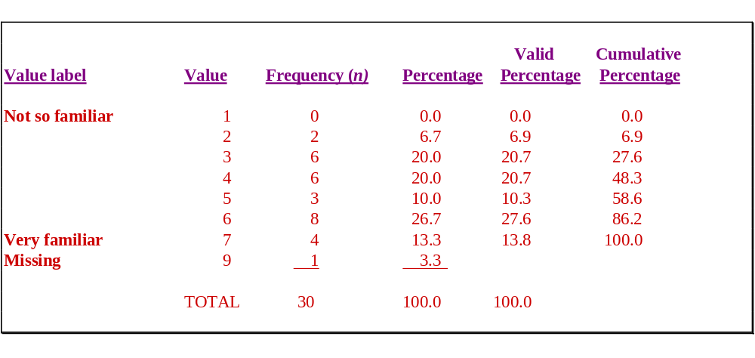
Frequency of Familiarity with the Internet

Slide 5
Statistics Associated with Frequency Distribution: Measures of Shape
Skewness. The tendency of the deviations from the mean to be larger in one direction than in the other. It can be thought of as the tendency for one tail of the distribution to be heavier than the other.
Kurtosis is a measure of the relative peakedness or flatness of the curve defined by the frequency distribution. The kurtosis of a normal distribution is zero. If the kurtosis is positive, then the distribution is more peaked than a normal distribution. A negative value means that the distribution is flatter than a normal distribution.

Slide 6
Skewness of a Distribution
Symmetric Distribution
Skewed Distribution
Mean Median Mode (a)
Mean Median Mode (b)

Slide 7

Steps Involved in Hypothesis Testing
Formulate H₀ and H₁
Select Appropriate Test
Choose Level of Significance
Collect Data and Calculate Test Statistic
Determine Probability Associated with Test Statistic
Determine Critical Value of Test Statistic TS_{CR}
Determine if TS_{CAL} falls into (Non) Rejection Region
Compare with Level of Significance, α
Reject or Do not Reject H₀
Draw Marketing Research Conclusion

Slide 8
A General Procedure for Hypothesis Testing
Step 1: Formulate the Hypothesis
A null hypothesis is a statement of the status quo, one of no difference or no effect. If the null hypothesis is not rejected, no changes will be made.
An alternative hypothesis is one in which some difference or effect is expected. Accepting the alternative hypothesis will lead to changes in opinions or actions.

Slide 9
A General Procedure for Hypothesis Testing
Step 1: Formulate the Hypothesis
A null hypothesis may be rejected, but it can never be accepted based on a single test. In classical hypothesis testing, there is no way to determine whether the null hypothesis is true.
In marketing research, the null hypothesis is formulated in such a way that its rejection leads to the acceptance of the desired conclusion. The alternative hypothesis represents the conclusion for which evidence is sought.
H
:
π
≤
0
.
4
0
0
H
1
:
π
>
0
.
40

Slide 10
A General Procedure for Hypothesis Testing
Step 1: Formulate the Hypothesis
The test of the null hypothesis is a one-tailed test, because the alternative hypothesis is expressed directionally. If that is not the case, then a two-tailed test would be required, and the hypotheses would be expressed as:
H
:
π
=
0
.
4
0
0
H
:
π
≠
0
.
4
0
1

Slide 11
A General Procedure for Hypothesis Testing
Step 2: Select an Appropriate Test
The test statistic measures how close the sample has come to the null hypothesis.
The test statistic often follows a well-known distribution, such as the normal, t, or chi-square distribution.
In our example, the z statistic, which follows the standard normal distribution, would be appropriate.
p
-
π
z
=
σ
p
where
π
(
1
−
π
)
σ
=
p
n

Slide 12
A General Procedure for Hypothesis Testing
Step 3: Choose a Level of Significance
Type I Error
Type I error occurs when the sample results lead to the rejection of the null hypothesis when it is in fact true.
The probability of type I error ( ) is also called the level of significance.
Type II Error
Type II error occurs when, based on the sample results, the null hypothesis is not rejected when it is in fact false.
The probability of type II error is denoted by .
Unlike , which is specified by the researcher, the magnitude of depends on the actual value of the population parameter (proportion).
α
β
α
β

Slide 13
A General Procedure for Hypothesis Testing
Step 3: Choose a Level of Significance
Power of a Test
The power of a test is the probability (1 - ) of rejecting the null hypothesis when it is false and should be rejected.
Although is unknown, it is related to . An extremely low value of (e.g., = 0.001) will result in intolerably high errors.
So, it is necessary to balance the two types of errors.
β
β
α
α
α
β

Slide 14
Probability of z with a One-Tailed Test
Shaded Area
= 0.9699
Unshaded Area
= 0.0301
0
z = 1.88

Slide 15
A General Procedure for Hypothesis Testing
Step 4: Collect Data and Calculate Test Statistic
The required data are collected and the value of the test statistic computed.
In our example, the value of the sample proportion is
= 17/30 = 0.567.
The value of can be determined as follows:
p
σ
p
σ
π
(
1
-
π
)
p
=
n
=
(0.40)(0.6)
30
= 0.089

Slide 16
A General Procedure for Hypothesis Testing
Step 4: Collect Data and Calculate Test Statistic
The test statistic z can be calculated as follows:
ˆ
−
π
p
z
=
σ
p
= 0.567-0.40
0.089
= 1.88

Slide 17
A General Procedure for Hypothesis Testing
Step 5: Determine the Probability (Critical Value)
Using standard normal tables (Table 2 of the Statistical Appendix), the probability of obtaining a z value of 1.88 can be calculated.
The shaded area between - and 1.88 is 0.9699. Therefore, the area to the right of z = 1.88 is 1.0000 - 0.9699 = 0.0301.
Alternatively, the critical value of z, which will give an area to the right side of the critical value of 0.05, is between 1.64 and 1.65 and equals 1.645.
Note, in determining the critical value of the test statistic, the area to the right of the critical value is either or . It is for a one-tail test and for a two-tail test.
∞
α
α
/2
α
α
/2

Slide 18
A General Procedure for Hypothesis Testing Steps 6 &7:
Compare the Probability (Critical Value) & Making the Decision
If the probability associated with the calculated or observed value of the test statistic (TSCAL) is less than the level of significance ( ), the null hypothesis is rejected.
The probability associated with the calculated or observed value of the test statistic is 0.0301. This is less than the level of significance of 0.05. Hence, the null hypothesis is rejected.
Alternatively, if the absolute calculated value of the test statistic (|TS_{CAL}|) is greater than the absolute critical value of the test statistic (|TS_{CR} |), the null hypothesis is rejected.
α

Slide 19
A General Procedure for Hypothesis Testing Steps 6 & 7: Compare the Probability (Critical Value) & Making the Decision
The calculated value of the test statistic z = 1.88 lies in the rejection region, beyond the value of 1.645. Again, the same conclusion to reject the null hypothesis is reached.
Note that the two ways of testing the null hypothesis are equivalent but mathematically opposite in the direction of comparison.
If the probability of TS_{CAL} < significance level ( ) then reject H₀ but if |TS_{CAL} | > |TS_{CR}| then reject H₀.
α

Slide 20
A General Procedure for Hypothesis Testing
Step 8: Marketing Research Conclusion
The conclusion reached by hypothesis testing must be expressed in terms of the marketing research problem.
In our example, we conclude that there is evidence that the proportion of Internet users who shop via the Internet is significantly greater than 0.40. Hence, the recommendation to the department store would be to introduce the new Internet shopping service.

Slide 21

A Broad Classification of Hypothesis Tests
Hypothesis Tests
Tests of Association
Tests of Differences
Proportions
Median/ Rankings
Distributions
Means

Slide 22
Cross-Tabulation
While a frequency distribution describes one variable at a time, a cross-tabulation describes two or more variables simultaneously.
Cross-tabulation results in tables that reflect the joint distribution of two or more variables with a limited number of categories or distinct values.

Slide 23

Gender and Internet Usage
Gender
Row
Internet Usage
Male
Female
Total
Light (1)
5
10
15
Heavy (2)
10
5
15
Column Total 15
1
5

Slide 24
Two Variables Cross-Tabulation
Since two variables have been cross-classified, percentages could be computed either columnwise, based on column totals or rowwise, based on row totals.
The general rule is to compute the percentages in the direction of the independent variable, across the dependent variable.

Slide 25
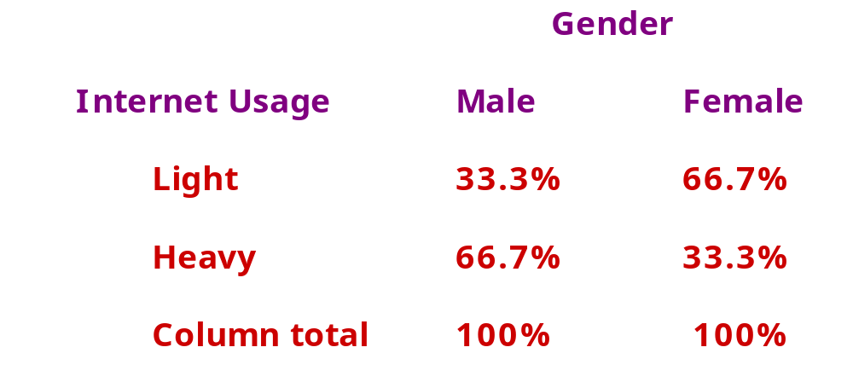

Internet Usage by Gender

Slide 26
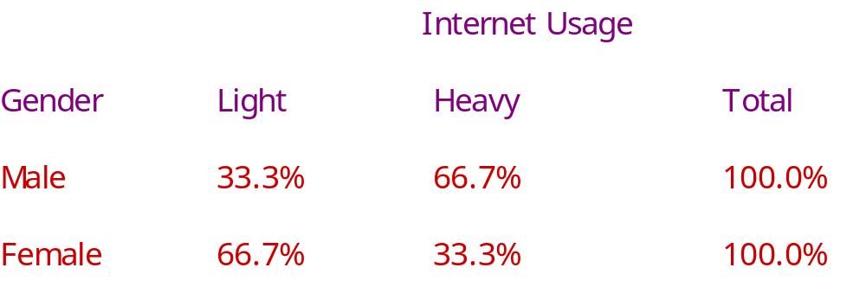

Gender by Internet Usage

Slide 27
Chi-square Distribution
Do Not Reject H₀
Reject H₀
^{χ 2}
Critical
Value

Slide 28
Statistics Associated with
Cross-Tabulation Chi-Square
χ
2
The chi-square statistic ( ) is used to test the statistical significance of the observed association in a cross-tabulation.
The expected frequency for each cell can be calculated by using a simple formula:
n
r
n
c
f
e
=
n
where n_{r} = total number in the row
n_{c} = total number in the column
n = total sample size

Slide 29
Statistics Associated with
Cross-Tabulation Chi-Square
For the above example, the expected frequencies for the cells going from left to right and from top to bottom, are:
Then the value of is calculated as follows:
15
X
15
15
X
15
=
7.50
=
7.50
30
30
15
X
15
15
X
15
=
7.50
=
7.50
30
30
χ
2
Σ
(
f
-
f
)
2
χ
2
=
o
e
f
e

Slide 30
Statistics Associated with
Cross-Tabulation Chi-Square
For the data in Internet usage table, the value of is
calculated as:
= (5 -7.5)² + (10 - 7.5)² + (10 - 7.5)² + (5 - 7.5)²
7.5 7.5 7.5 7.5
=0.833 + 0.833 + 0.833+ 0.833
= 3.333
χ
2

Slide 31
Statistics Associated with Cross-Tabulation
Chi-Square
To determine whether a systematic association exists, the probability of obtaining a value of chi-square as large or larger than the one calculated from the cross-tabulation is estimated.
An important characteristic of the chi-square statistic is the number of degrees of freedom (df) associated with it. That is, df = (r - 1) x (c -1).
The null hypothesis (H₀) of no association between the two variables will be rejected only when the calculated value of the test statistic is greater than the critical value of the chi-square distribution with the appropriate degrees of freedom, as shown in Figure 15.8.

Slide 32
Statistics Associated with
Cross-Tabulation Chi-Square
The chi-square distribution is a skewed distribution whose shape depends solely on the number of degrees of freedom. As the number of degrees of freedom increases, the chi-square distribution becomes more symmetrical.
Table 3 in the Statistical Appendix contains upper-tail areas of the chi-square distribution for different degrees of freedom. For 1 degree of freedom, the probability of exceeding a chi-square value of 3.841 is 0.05.
For the considered example, there are (2-1) x (2-1) = 1 degree of freedom. The calculated chi-square statistic had a value of 3.333. Since this is less than the critical value of 3.841, the null hypothesis of no association can not be rejected indicating that the association is not statistically significant at the 0.05 level.

Slide 33
Statistics Associated with
Cross-Tabulation Phi Coefficient
φ
The phi coefficient ( ) is used as a measure of the strength of association in the special case of a table with two rows and two columns (a 2 x 2 table).
The phi coefficient is proportional to the square root of the chi-square statistic
It takes the value of 0 when there is no association, which would be indicated by a chi-square value of 0 as well. When the variables are perfectly associated, phi assumes the value of 1.
χ
2
φ
=
n

Slide 34
Statistics Associated with Cross-Tabulation
Contingency Coefficient
While the phi coefficient is specific to a 2 x 2 table, the contingency coefficient (C) can be used to assess the strength of association in a table of any size.
The contingency coefficient varies between 0 and 1.
The maximum value of the contingency coefficient depends on the size of the table (number of rows and number of columns). For this reason, it should be used only to compare tables of the same size.
χ
2
C
=
χ
2
+
n

Slide 35
Statistics Associated with Cross-Tabulation
Cramer’s V
Cramer's V is a modified version of the phi correlation coefficient, , and is used in tables larger than 2 x 2.
or
φ
φ
2
V
=
m
i
n
(
r
-
1
)
,
(
c
-
1
)
χ
2
/
n
V
=
m
i
n
(
r
-
1
)
,
(
c
-
1
)

Slide 36
Introduction of a Third Variable in Cross-Tabulation
Original Two Variables
Some Association between the Two Variables
No Association between the Two Variables
Introduce a Third Variable
Introduce a Third Variable
Refined Association between the Two Variables
No Association between the Two Variables
No Change in the Initial Pattern
Some Association between the Two Variables

Slide 37

Ownership of Expensive Automobiles by Education Level
Table 1
Own Expensive
Education
Automobile
College Degree
No College Degree
Yes
No
Column totals
Number of cases
32%
68%
100%
250
21%
79%
100%
750

Slide 38
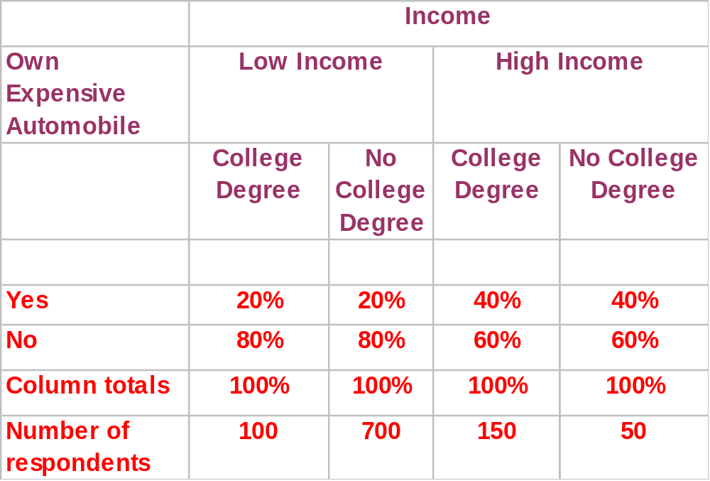
Ownership of Expensive Automobiles by Education Level and Income Levels
Table 2

Slide 39
Three Variables Cross-Tabulation Initial Relationship was Spurious
Table 1 shows that 32% of those with college degrees own an expensive automobile, as compared to 21% of those without college degrees. Realizing that income may also be a factor, the researcher decided to reexamine the relationship between education and ownership of expensive automobiles in light of income level.
In Table 2, the percentages of those with and without college degrees who own expensive automobiles are the same for each of the income groups. When the data for the high income and low income groups are examined separately, the association between education and ownership of expensive automobiles disappears, indicating that the initial relationship observed between these two variables was spurious.

Slide 40
Three Variables Cross-Tabulation
Reveal Suppressed Association
Table 3 shows no association between desire to travel abroad and age.
When sex was introduced as the third variable, Table 4 was obtained. Among men, 60% of those under 45 indicated a desire to travel abroad, as compared to 40% of those 45 or older. The pattern was reversed for women, where 35% of those under 45 indicated a desire to travel abroad as opposed to 65% of those 45 or older.
Since the association between desire to travel abroad and age runs in the opposite direction for males and females, the relationship between these two variables is masked when the data are aggregated across sex, as in Table 3.
But when the effect of sex is controlled, as in Table 4, the suppressed association between desire to travel abroad and age is revealed for the separate categories of males and females.

Slide 41
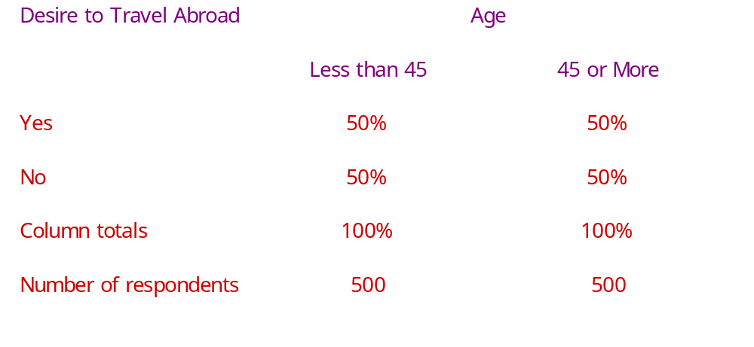




Desire to Travel Abroad by Age
Table 3

Slide 42
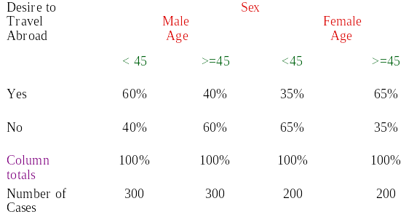
Desire to Travel Abroad by Age and Gender
Table 4

Slide 43
Three Variables Cross-Tabulations
No Change in Initial Relationship
Consider the cross-tabulation of family size and the tendency to eat out frequently in fast-food restaurants, as shown in Table 5. No association is observed.
When income was introduced as a third variable in the analysis, Table 6 was obtained. Again, no association was observed.

Slide 44
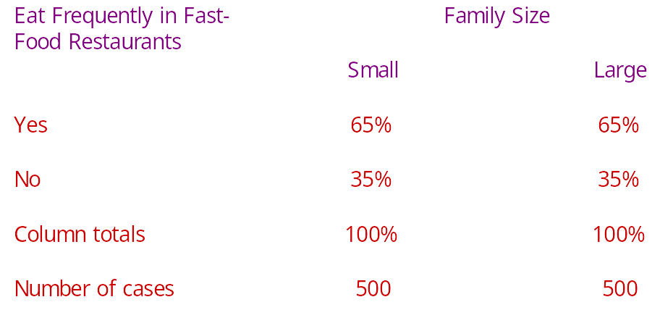

Eating Frequently in
Fast-Food Restaurants by Family Size
Table 5

Slide 45

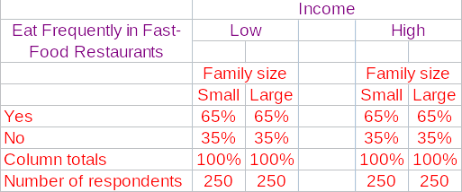

Eating Frequently in Fast-Food Restaurants by Family Size and Income
Table 6

Slide 46
Hypothesis Testing Related to Differences
Parametric tests assume that the variables of interest are measured on at least an interval scale.
Nonparametric tests assume that the variables are measured on a nominal or ordinal scale.
These tests can be further classified based on whether one or two or more samples are involved.
The samples are independent if they are drawn randomly from different populations. For the purpose of analysis, data pertaining to different groups of respondents, e.g., males and females, are generally treated as independent samples.
The samples are paired when the data for the two samples relate to the same group of respondents.

Slide 47
A Classification of Hypothesis Testing Procedures for Examining Differences
Hypothesis Tests
Parametric Tests (Metric Tests)
Non-parametric Tests (Nonmetric Tests)
One Sample
Two or More Samples
One Sample
Two or More Samples
* t test
* Z test
* Chi-Square * K-S
* Runs
* Binomial
Independent Samples
Paired Samples
Independent Samples
Paired Samples
* Two-Group t test
* Z test
* Paired
t test
* Chi-Square
* Mann-Whitney
* Median
* K-S
* Sign
* Wilcoxon
* McNemar
Chi-Square

Slide 48
Parametric Tests
The t statistic assumes that the variable is normally distributed and the mean is known (or assumed to be known) and the population variance is estimated from the sample.
Assume that the random variable X is normally distributed, with mean and unknown population variance that is estimated by the sample variance s².
Then, is t distributed with n - 1 degrees of freedom.
The t distribution is similar to the normal distribution in appearance. Both distributions are bell-shaped and symmetric. As the number of degrees of freedom increases, the t distribution approaches the normal distribution.
t
=
(
X
-
μ
)
/
s
X

Slide 49
Hypothesis Testing Using the t Statistic
Formulate the null (H₀) and the alternative (H₁) hypotheses.
Select the appropriate formula for the t statistic.
Select a significance level, α , for testing H₀. Typically, the 0.05 level is selected.
Take one or two samples and compute the mean and standard deviation for each sample.
Calculate the t statistic assuming H₀ is true.

Slide 50
Hypothesis Testing Using the t Statistic
Calculate the degrees of freedom and estimate the probability of getting a more extreme value of the statistic from Table 4. (Alternatively, calculate the critical value of the t statistic.)
If the probability computed in step 5 is smaller than the significance level selected in step 2, reject H₀. If the probability is larger, do not reject H₀. (Alternatively, if the absolute value of the calculated t statistic in step 4 is larger than the absolute critical value determined in step 5, reject H₀.) Failure to reject H₀ does not necessarily imply that H₀ is true. It only means that the true state is not significantly different than that assumed by H_{0.}
Express the conclusion reached by the t test in terms of the marketing research problem.

Slide 51





One Sample : t Test
For the data in Table above, suppose we wanted to test
the hypothesis that the mean familiarity rating exceeds
4.0, the neutral value on a 7-point scale. A significance
level of = 0.05 is selected. The hypotheses may be
formulated as:
α
H₀:
< 4.0
H₁:
> 4.0
=
= 1.579/5.385 = 0.293
t = (4.724-4.0)/0.293 = 0.724/0.293 = 2.471

Slide 52
One Sample : t Test
The degrees of freedom for the t statistic to test the hypothesis about one mean are n - 1. In this case, n - 1 = 29 - 1 or 28. From Table 4 in the Statistical Appendix, the probability of getting a more extreme value than 2.471 is less than 0.05. (Alternatively, the critical t value for 28 degrees of freedom and a significance level of 0.05 is 1.7011, which is less than the calculated value.) Hence, the null hypothesis is rejected. The familiarity level does exceed 4.0.

Slide 53



One Sample : Z Test
Note that if the population standard deviation was assumed to be known as 1.5, rather than estimated from the sample, a z test would be appropriate. In this case, the value of the z statistic would be:
where
= = 1.5/5.385 = 0.279
and
z = (4.724 - 4.0)/0.279 = 0.724/0.279 = 2.595

Slide 54
One Sample : Z Test
From Table 2 in the Statistical Appendix, the probability of getting a more extreme value of z than 2.595 is less than 0.05. (Alternatively, the critical z value for a one-tailed test and a significance level of 0.05 is 1.645, which is less than the calculated value.) Therefore, the null hypothesis is rejected, reaching the same conclusion arrived at earlier by the t test.
The procedure for testing a null hypothesis with respect to a proportion was illustrated earlier in this chapter when we introduced hypothesis testing.

Slide 55


Two Independent Samples F Test
An F test of sample variance may be performed if it is
not known whether the two populations have equal
variance. In this case, the hypotheses are:
H₀: ₁² = ₂²
H₁: ₁² ₂²

Slide 56
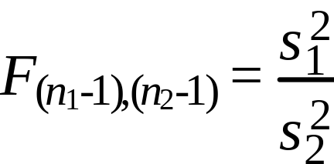
Two Independent Samples F Statistic
The F statistic is computed from the sample variances
as follows:
where
n₁ = size of sample 1
n₂ = size of sample 2
n₁-1 = degrees of freedom for sample 1
n₂-1 = degrees of freedom for sample 2
s₁² = sample variance for sample 1
s₂² = sample variance for sample 2
Suppose we wanted to determine whether Internet usage was different for males as compared to females. A two-independent-samples t test was conducted. The results are presented in the next Table.

Slide 57
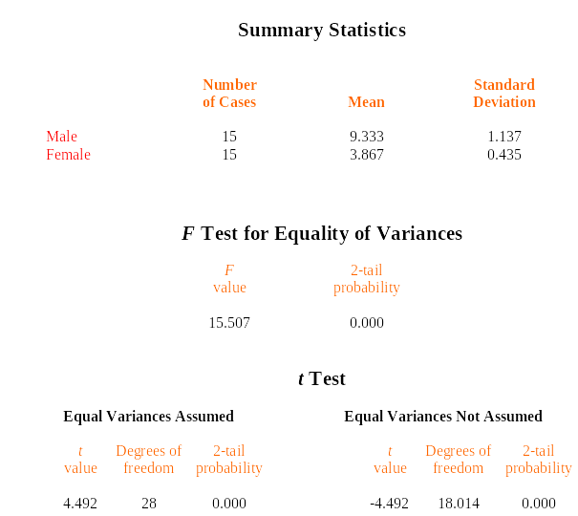

Two Independent-Samples t Tests
Table 15.14
-

Slide 58
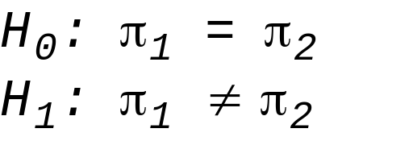
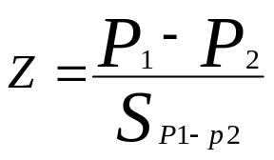
Two Independent Samples Proportions
The case involving proportions for two independent samples is also illustrated using the same data, which gives the number of males and females who use the Internet for shopping. Is the proportion of respondents using the Internet for shopping the same for males and females?
The null and alternative hypotheses are:
A Z test is used as in testing the proportion for one sample.
However, in this case the test statistic is given by:

Slide 59
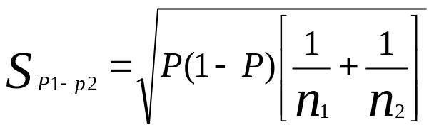
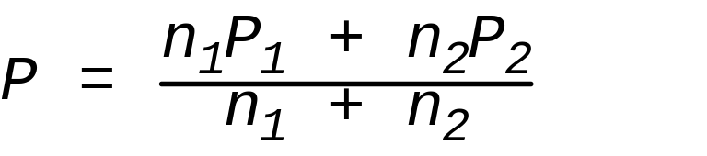
Two Independent Samples Proportions
In the test statistic, the numerator is the difference between the proportions in the two samples, P1 and P2. The denominator is the standard error of the difference in the two proportions and is given by
where

Slide 60



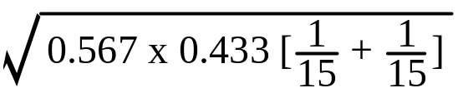
Two Independent Samples Proportions
A significance level of = 0.05 is selected. Given the data of Table 15.1, the test statistic can be calculated as:
= (11/15) -(6/15)
= 0.733 - 0.400 = 0.333
P = (15 x 0.733+15 x 0.4)/(15 + 15) = 0.567
= = 0.181
Z = 0.333/0.181 = 1.84

Slide 61
Two Independent Samples Proportions
Given a two-tail test, the area to the right of the critical value is 0.025. Hence, the critical value of the test statistic is 1.96. Since the calculated value is less than the critical value, the null hypothesis can not be rejected. Thus, the proportion of users (0.733 for males and 0.400 for females) is not significantly different for the two samples. Note that while the difference is substantial, it is not statistically significant due to the small sample sizes (15 in each group).

Slide 62
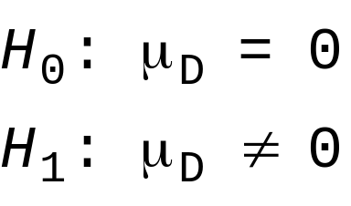
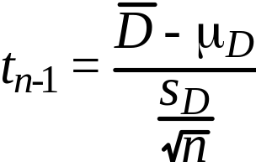
Paired Samples
The difference in these cases is examined by a paired samples t test. To compute t for paired samples, the paired difference variable, denoted by D, is formed and its mean and variance calculated. Then the t statistic is computed. The degrees of freedom are n - 1, where n is the number of pairs. The relevant formulas are:
continued…

Slide 63
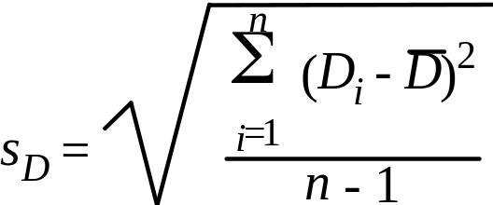
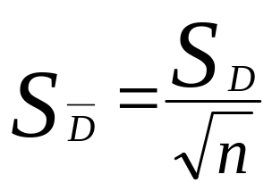
Paired Samples
Where:
In the Internet usage example, a paired t test could be used to determine if the respondents differed in their attitude toward the Internet and attitude toward technology. The resulting output is shown in next Table.
n
Σ
D
i
D
=
i
=
1
n

Slide 64

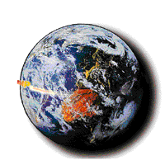
Paired-Samples t Test
Number
Standard
Standard
Variable
of Cases
Mean
Deviation
Error
Internet Attitude
30
5.167
1.234
0.225
Technology Attitude
30
4.100
1.398
0.255
Difference = Internet
- Technology
Difference
Standard
Standard
2
-
tail
t
Degrees of
2
-
tail
Mean
deviation
error
Correlation
prob.
value
freedom
probability
1.067
0.828
0
.1511
0
.809
0
.000
7.059
29
0
.000

Slide 65
Nonparametric Tests
Nonparametric tests are used when the independent variables are nonmetric. Like parametric tests, nonparametric tests are available for testing variables from one sample, two independent samples, or two related samples.

Slide 66
Nonparametric Tests One Sample
Sometimes the researcher wants to test whether the observations for a particular variable could reasonably have come from a particular distribution, such as the normal, uniform, or Poisson distribution.
The Kolmogorov-Smirnov (K-S) one-sample test is one such goodness-of-fit test. The K-S compares the cumulative distribution function for a variable with a specified distribution. A_{i} denotes the cumulative relative frequency for each category of the theoretical (assumed) distribution, and O_{i} the comparable value of the sample frequency. The K-S test is based on the maximum value of the absolute difference between A_{i} and O_{i}. The test statistic is
K
=
M
a
x
A
-
O
i
i

Slide 67


Nonparametric Tests One Sample
The decision to reject the null hypothesis is based on the value of K. The larger the K is, the more confidence we have that H₀ is false. For = 0.05, the critical value of K for large samples (over 35) is given by 1.36/ . Alternatively, K can be transformed into a normally distributed z statistic and its associated probability determined.
In the context of the Internet usage example, suppose we wanted to test whether the distribution of Internet usage was normal. A K-S one-sample test is conducted, yielding the data shown in Table 7. Table 7 indicates that the probability of observing a K value of 0.222, as determined by the normalized z statistic, is 0.103. Since this is more than the significance level of 0.05, the null hypothesis can not be rejected, leading to the same conclusion. Hence, the distribution of Internet usage does not deviate significantly from the normal distribution.

Slide 68
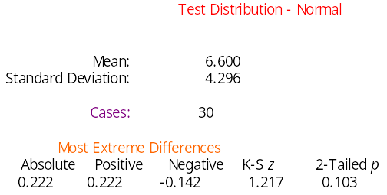

K-S One-Sample Test for Normality of Internet Usage
Table 7

Slide 69
Nonparametric Tests One Sample
The chi-square test can also be performed on a single variable from one sample. In this context, the chi-square serves as a goodness-of-fit test.
The runs test is a test of randomness for the dichotomous variables. This test is conducted by determining whether the order or sequence in which observations are obtained is random.
The binomial test is also a goodness-of-fit test for dichotomous variables. It tests the goodness of fit of the observed number of observations in each category to the number expected under a specified binomial distribution.

Slide 70
Nonparametric Tests Two Independent Samples
When the difference in the location of two populations is to be compared based on observations from two independent samples, and the variable is measured on an ordinal scale, the Mann-Whitney U test can be used.
In the Mann-Whitney U test, the two samples are combined and the cases are ranked in order of increasing size.
The test statistic, U, is computed as the number of times a score from sample or group 1 precedes a score from group 2.
If the samples are from the same population, the distribution of scores from the two groups in the rank list should be random. An extreme value of U would indicate a nonrandom pattern, pointing to the inequality of the two groups.
For samples of less than 30, the exact significance level for U is computed. For larger samples, U is transformed into a normally distributed z statistic. This z can be corrected for ties within ranks.

Slide 71
Nonparametric Tests Two Independent Samples
We examine again the difference in the Internet usage of males and females. This time, though, the Mann-Whitney U test is used. The results are given in Table 8.
The two-sample median test determines whether the two groups are drawn from populations with the same median. It is not as powerful as the Mann-Whitney U test because it merely uses the location of each observation relative to the median, and not the rank, of each observation.
The Kolmogorov-Smirnov two-sample test examines whether the two distributions are the same. It takes into account any differences between the two distributions, including the median, dispersion, and skewness.

Slide 72

Mann-Whitney U - Wilcoxon Rank
Sum W Test Internet Usage by Gender
Table 8
Sex
Mean Rank
Cases
Male
20.93
15
Female
10.07
15
Total
30
Corrected for ties
U
W
z
2
-
tailed
p
31.000
151.000
-
3.406
0.001
Note
U
= Mann
-
Whitney test statistic
W
= Wilcoxon W Statistic
z
= U transformed into normally distributed
z
statistic

Slide 73
Nonparametric Tests Paired Samples
The Wilcoxon matched-pairs signed-ranks test analyzes the differences between the paired observations, taking into account the magnitude of the differences.
It computes the differences between the pairs of variables and ranks the absolute differences.
The next step is to sum the positive and negative ranks. The test statistic, z, is computed from the positive and negative rank sums.
Under the null hypothesis of no difference, z is a standard normal variate with mean 0 and variance 1 for large samples.

Slide 74
Nonparametric Tests Paired Samples
The example considered for the paired t test, whether the respondents differed in terms of attitude toward the Internet and attitude toward technology, is considered again. Suppose we assume that both these variables are measured on ordinal rather than interval scales. Accordingly, we use the Wilcoxon test. The results are shown in Table 9.
The sign test is not as powerful as the Wilcoxon matched-pairs signed-ranks test as it only compares the signs of the differences between pairs of variables without taking into account the ranks.
In the special case of a binary variable where the researcher wishes to test differences in proportions, the McNemar test can be used. Alternatively, the chi-square test can also be used for binary variables.

Slide 75
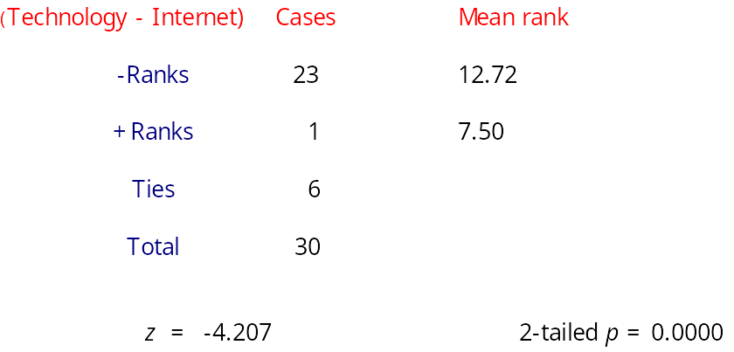

Wilcoxon Matched-Pairs Signed-Rank Test Internet with Technology
Table 9

Slide 76
A Summary of Hypothesis Tests Related to Differences
Sample
Application
Level of Scaling
Test/Comments
Proportion
Metric
Z test
One Sample
K-S and chi-square for
One Sample
Distributions
Nonmetric
goodness of fit
Runs test for randomness
Binomial test for goodness of
fit for dichotomous variables
One Sample
Means
Metric
t
test, if variance is unknown
z
test, if variance is known

Slide 77
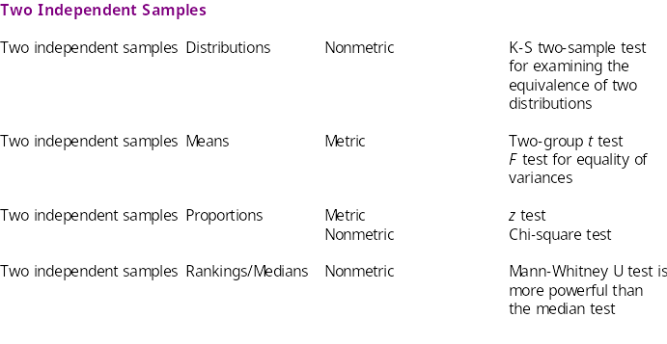
A Summary of Hypothesis Tests Related to Differences

Slide 78
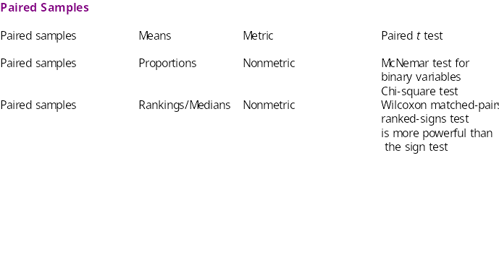
A Summary of Hypothesis Tests Related to Differences

Slide 79
SPSS Windows
The main program in SPSS is FREQUENCIES. It produces a table of frequency counts, percentages, and cumulative percentages for the values of each variable. It gives all of the associated statistics.
If the data are interval scaled and only the summary statistics are desired, the DESCRIPTIVES procedure can be used.
The EXPLORE procedure produces summary statistics and graphical displays, either for all of the cases or separately for groups of cases. Mean, median, variance, standard deviation, minimum, maximum, and range are some of the statistics that can be calculated.

Slide 80
SPSS Windows
To select these procedures click:
Analyze>Descriptive Statistics>Frequencies
Analyze>Descriptive Statistics>Descriptives
Analyze>Descriptive Statistics>Explore
The major cross-tabulation program is CROSSTABS.
This program will display the cross-classification tables and provide cell counts, row and column percentages, the
chi-square test for significance, and all the measures of the strength of the association that have been discussed.
To select these procedures, click:
Analyze>Descriptive Statistics>Crosstabs

Slide 81
SPSS Windows
The major program for conducting parametric tests in SPSS is COMPARE MEANS. This program can be used to conduct t tests on one sample or independent or paired samples. To select these procedures using SPSS for Windows, click:
Analyze>Compare Means>Means …
Analyze>Compare Means>One-Sample T Test …
Analyze>Compare Means>Independent-Samples T Test …
Analyze>Compare Means>Paired-Samples T Test …

Slide 82
SPSS Windows
The nonparametric tests discussed in this chapter can
be conducted using NONPARAMETRIC TESTS.
To select these procedures using SPSS for Windows,
click:
Analyze>Nonparametric Tests>Chi-Square …
Analyze>Nonparametric Tests>Binomial …
Analyze>Nonparametric Tests>Runs …
Analyze>Nonparametric Tests>1-Sample K-S …
Analyze>Nonparametric Tests>2 Independent Samples …
Analyze>Nonparametric Tests>2 Related Samples …

Slide 83
SPSS Windows: Frequencies
Select ANALYZE on the SPSS menu bar.
Click DESCRIPTIVE STATISTICS and select FREQUENCIES.
Move the variable “Familiarity [familiar]” to the VARIABLE(s) box.
Click STATISTICS.
Select MEAN, MEDIAN, MODE, STD. DEVIATION, VARIANCE, and RANGE.

Slide 84
SPSS Windows: Frequencies
Click CONTINUE.
Click CHARTS.
Click HISTOGRAMS, then click CONTINUE.
Click OK.

Slide 85
SPSS Windows: Cross-tabulations
Select ANALYZE on the SPSS menu bar.
Click on DESCRIPTIVE STATISTICS and select CROSSTABS.
Move the variable “Internet Usage Group [iusagegr]” to the ROW(S) box.
Move the variable “Sex[sex]” to the COLUMN(S) box.
Click on CELLS.
Select OBSERVED under COUNTS and COLUMN under PERCENTAGES.

Slide 86
SPSS Windows: Cross-tabulations
Click CONTINUE.
Click STATISTICS.
Click on CHI-SQUARE, PHI AND CRAMER’S V.
Click CONTINUE.
Click OK.

Slide 87
SPSS Windows: One Sample t Test
Select ANALYZE from the SPSS menu bar.
Click COMPARE MEANS and then ONE SAMPLE T TEST.
Move “Familiarity [familiar]” in to the TEST VARIABLE(S) box.
Type “4” in the TEST VALUE box.
Click OK.

Slide 88
SPSS Windows:
Two Independent Samples t Test
Select ANALYZE from the SPSS menu bar.
Click COMPARE MEANS and then INDEPENDENT SAMPLES T TEST.
Move “Internet Usage Hrs/Week [iusage]” in to the TEST VARIABLE(S) box.
Move “Sex[sex]” to GROUPING VARIABLE box.
Click DEFINE GROUPS.
Type “1” in GROUP 1 box and “2” in GROUP 2 box.
Click CONTINUE.
Click OK.

Slide 89
SPSS Windows: Paired Samples t Test
Select ANALYZE from the SPSS menu bar.
Click COMPARE MEANS and then PAIRED SAMPLES T TEST.
Select “Attitude toward Internet [iattitude]” and then select “Attitude toward technology [tattitude].” Move these variables in to the PAIRED VARIABLE(S) box.
Click OK.

Slide 90
SAS Learning Edition
The Summary Statistics task provides summary statistics including basic summary statistics, percentile summary statistics, and more advanced summary statistics including confidence intervals, t-statistics, coefficient of variation, and sums of squares.
The Summary Statistics task also provides graphical displays, including histograms and box-and-whisker plots.
The One-Way Frequencies task can be used to generate frequency tables as well as binominal and chi-square tests.

Slide 91
SAS Learning Edition
To select these tasks, click:
Describe>Summary Statistics
Describe>One-Way Frequencies
The major cross-tabulation program called TABLE ANALYSIS. This task will display the cross-classification tables and provide cell counts, row and column percentages, the chi-square test for significance, and all the measures of the strength of the association that have been discussed.
To select this task, click:
Describe>Table Analysis

Slide 92
SAS Learning Edition
The major program for conducting parametric
tests in SAS Learning Edition is T TEST. This task can be used to conduct t tests on one sample or
independent or paired samples. To select this task using SAS Learning Edition, click:
Analyze>ANOVA>t Test

Slide 93
SAS Learning Edition
The nonparametric tests discussed in this chapter can be conducted using NONPARAMETRIC ONE-WAY ANOVA. To select this task using SAS Learning Edition, click:
Analyze>ANOVA>Nonparametric One-way ANOVA

Slide 94
SAS Learning Edition: Frequencies
Select DESCRIBE on the SAS Learning Edition menu bar.
Click SUMMARY STATISTICS.
Move the variable “FAMILIARITY” to the Analysis variables role.
Click STATISTICS.
Select MEAN, STANDARD DEVIATION, VARIANCE, and RANGE.
Click Plots.
Click Histogram.
Click Run.

Slide 95
SAS Learning Edition: Cross-tabulations
Select DESCRIBE from the SAS Learning Edition menu bar.
Click TABLE ANALYSIS.
Move the variable “IUSAGEGROUP” and “SEX” to the Table variables role.
Click TABLES.
Move “SEX” and then “IUSAGEGROUP.”
Click CELL STATISTICS.

Slide 96
SAS Learning Edition: Cross-tabulations
Select COLUMN PERCENTAGES and CELL FREQUENCIES.
Click ASSOCIATION under TABLE STATISTICS.
Click CHI_SQUARE TESTS under TESTS of ASSOCIATION.
Click Run.

Slide 97
SAS Learning Edition: One Sample t Test
Select ANALYZE from the SAS Learning Edition menu bar.
Click ANOVA and then T TEST.
Click ONE SAMPLE.
Click TASK ROLES.
Move “FAMILIARITY” to the Analysis variables role.
Click ANALYSIS.
Enter “4” into the Null Hypothesis field.
Click Run.

Slide 98
SAS LE: Two Independent Samples t Test
Select ANALYZE from the SAS Learning Edition menu bar.
Click ANOVA and then T TEST.
Click TWO SAMPLE.
Click TASK ROLES.
Move “IUSAGE” to the Analysis variables role.
Move “SEX” to the Group by role.
Click Run.

Slide 99
SAS LE: Paired Samples t Test
Select ANALYZE from the SAS Learning Edition menu bar.
Click ANOVA and then T TEST.
Click PAIRED.
Click TASK ROLES.
Move “IATTITUDE” and “TATTITUDE” to the Paired variables role.
Click Run.

Slide 100
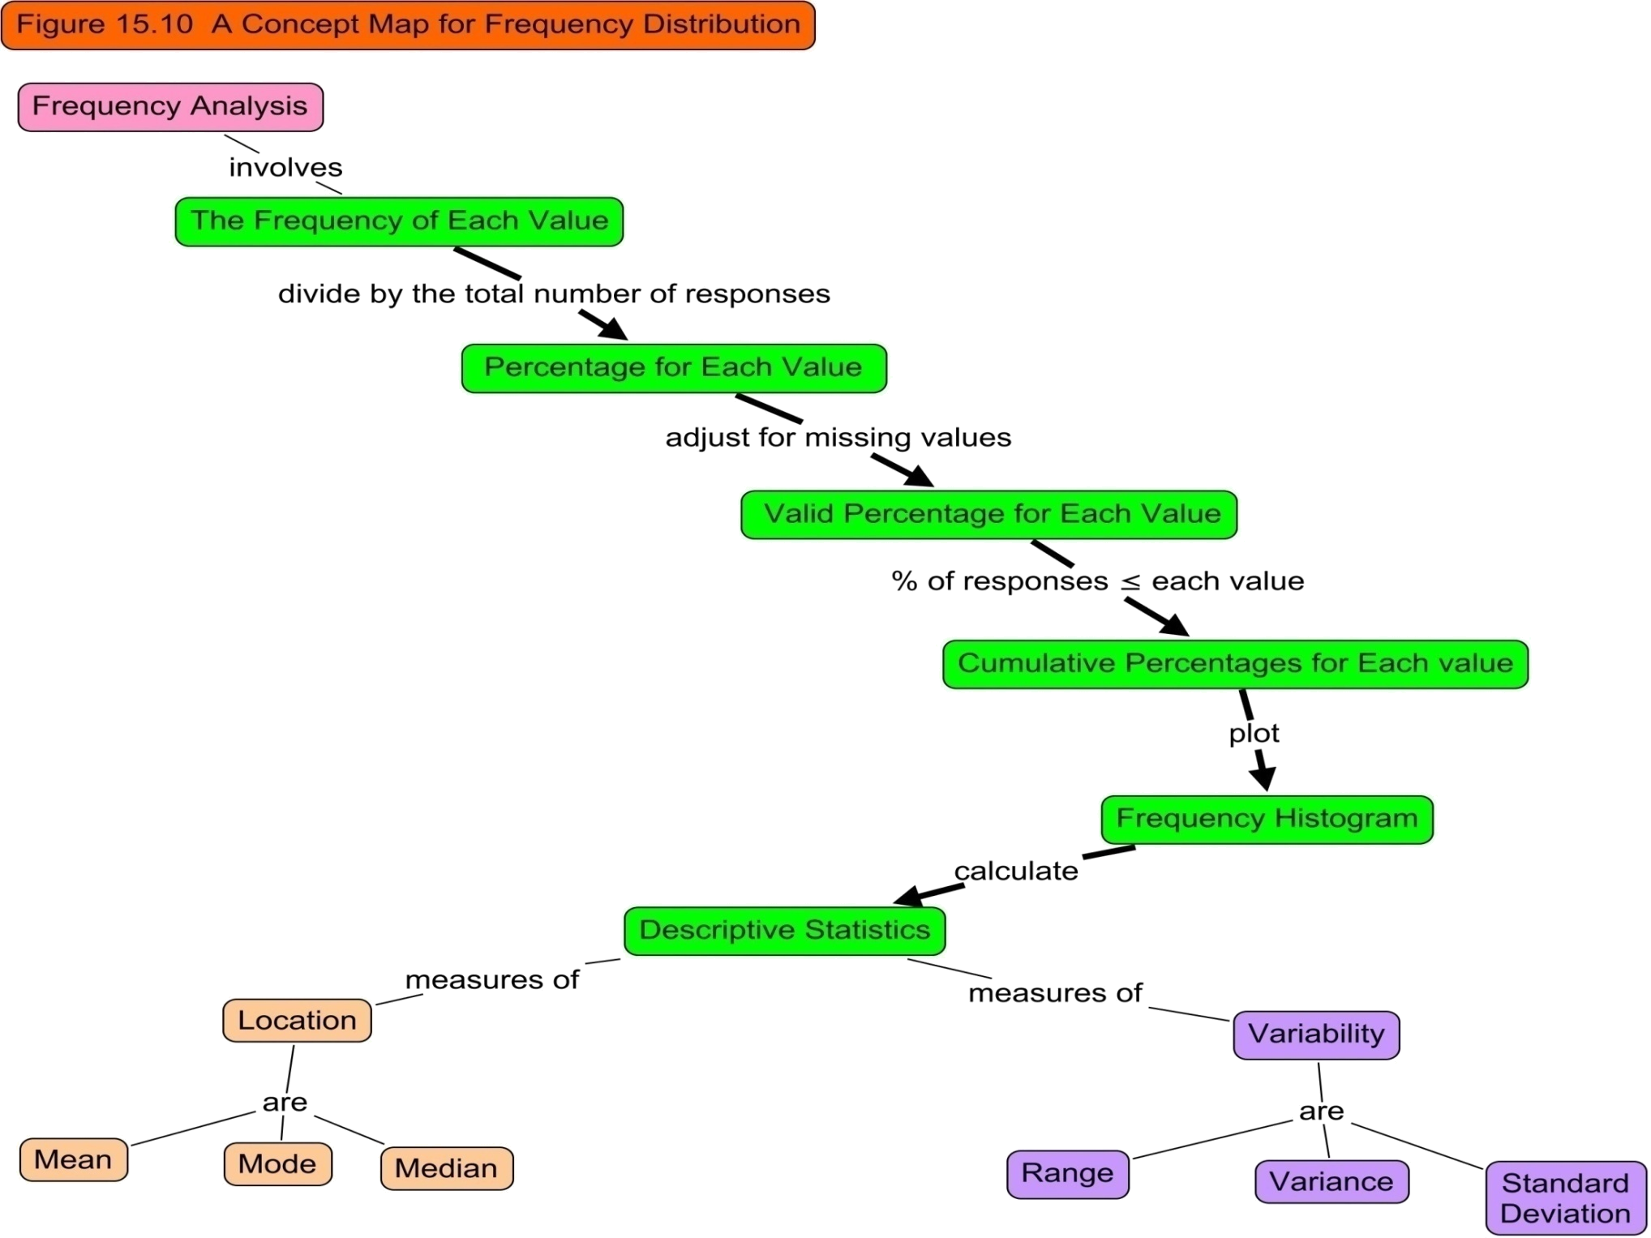

Slide 101
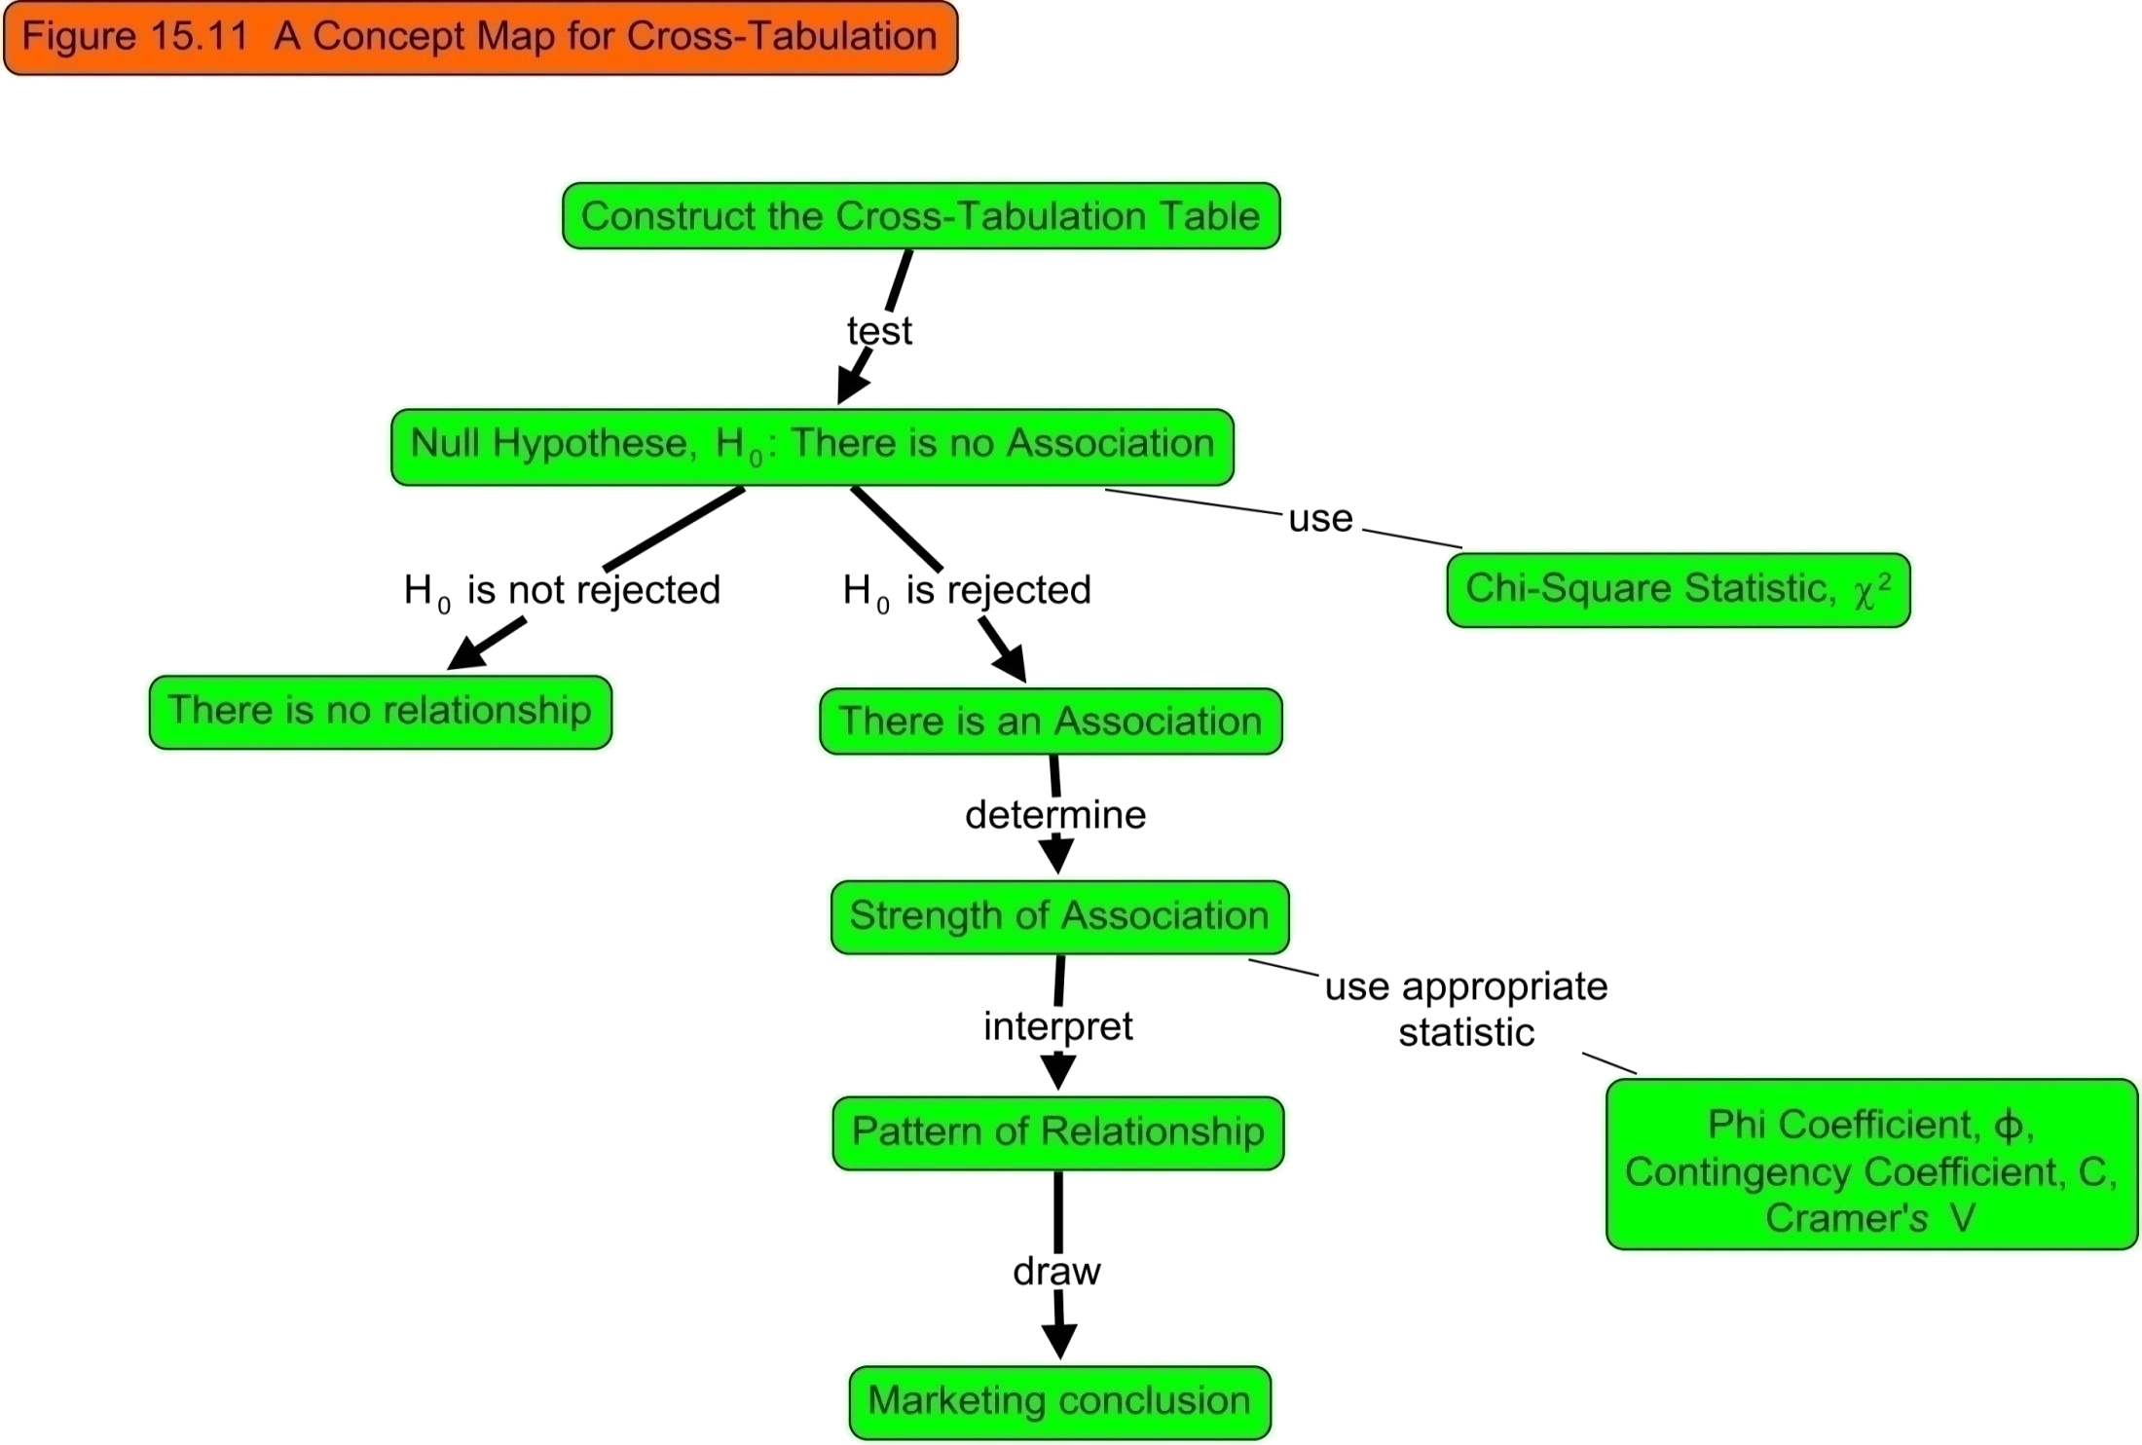

Slide 102
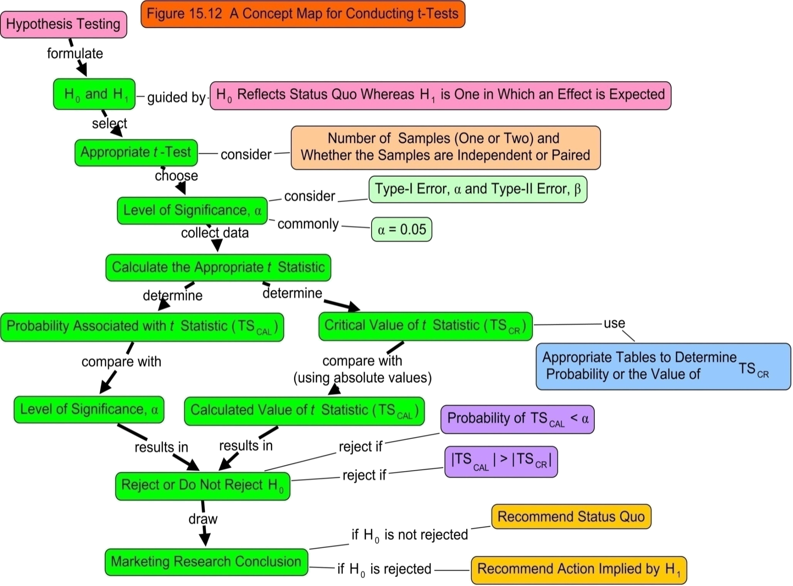

Slide 103

All rights reserved. No part of this publication may be reproduced, stored in a retrieval system, or transmitted, in any form or by any means, electronic, mechanical, photocopying, recording, or otherwise, without the prior written permission of the publisher. Printed in the United States of America.
Copyright © 2010 Pearson Education, Inc.

